Slide 1
MATH2010 Probability and STATISTICS
Le DUY DUNG
College of Engineering and Computer Science

Slide 2
From Lecture 6
Independent Bernoulli Trails
Binomial
Geometric
Negative
Binomial
Uniform and Poisson

Slide 3

Discrete Random Variable
https://padlet.com/leduydungttk54/hs6v2stywdwgfl9q

Slide 4
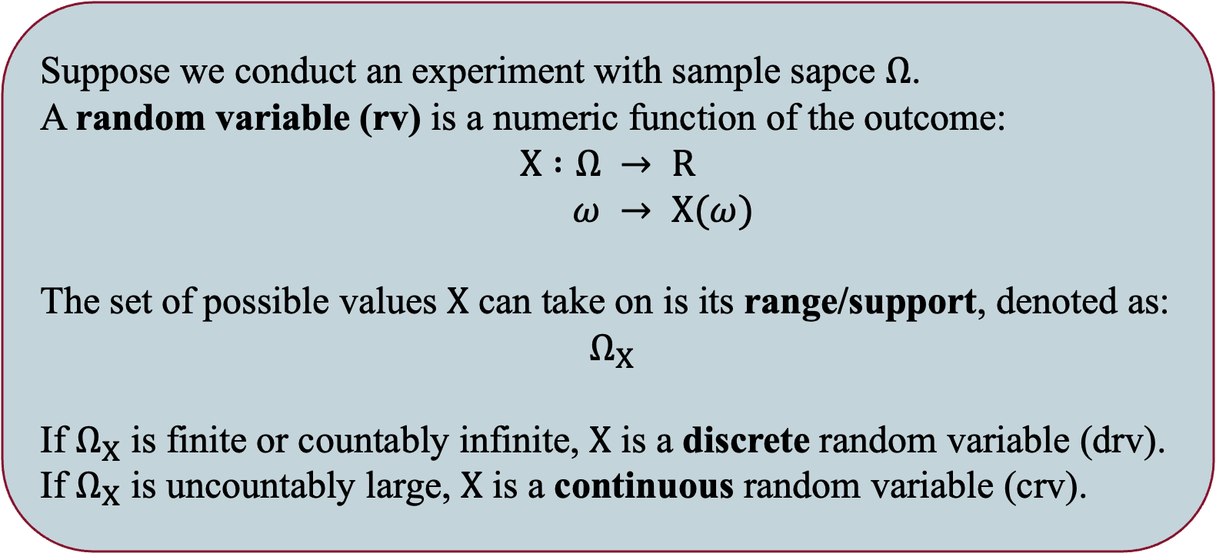
Random Variable (From Lecture 4)
Suppose we conduct an experiment with sample sapce $Ω$.
A random variable (rv) is a numeric function of the outcome:
$$X :Ω → R$$
$ω → X(ω)$
The set of possible values $X$ can take on is its range/support, denoted as:
$Ω_{X}$
If $Ω_{X}$ is finite or countably infinite, $X$ is a discrete random variable (drv).
If $Ω_{X}$ is uncountably large, $X$ is a continuous random variable (crv).

Slide 5






DISCRETE World and Continuous World
DISCRETE
CONTINUOUS
Random variable
$$X$$
Random variable
$$X$$
Probability Mass Function (PMF)
$$p_{X\left(k\right)}=P(X=k)$$
Probability Distribution Function (PDF)
$$f_{X}(x), k∈Ω_{X}$$
Cumulative Distribution Function (CDF)
$$F_{X}\left(t\right)=P(X≤t)$$
Cumulative Distribution Function (CDF)
$$F_{X}\left(t\right)=P(X≤t)$$

Slide 6
Learning GOALS
Know the definition of a continuous random variable.
Know the definition of the probability density function (PDF) and cumulative distribution function (CDF).
Be able to explain why we use probability density for continuous random variable.

Slide 7
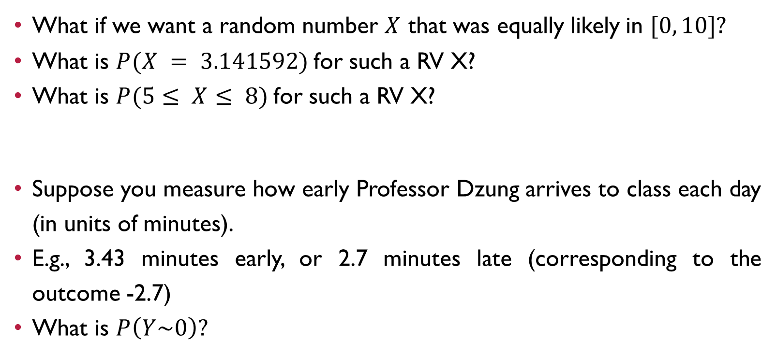
The need for continuous random variable
What if we want a random number $X$ that was equally likely in $[0, 10]?$
What is $P(X = 3.141592)$for such a RV X?
What is $P(5≤ X≤ 8)$for such a RV X?
Suppose you measure how early Professor Dzung arrives to class each day (in units of minutes).
E.g., 3.43 minutes early, or 2.7 minutes late (corresponding to the outcome -2.7)
What is $P\left(Y\sim 0\right)?$

Slide 8
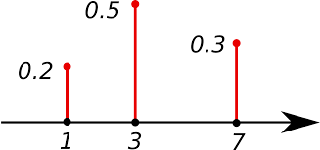
From Discrete World …
Probability Mass Function - PMF

Slide 9
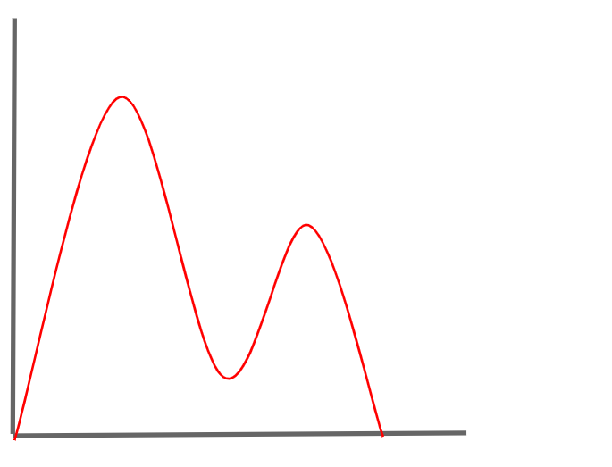
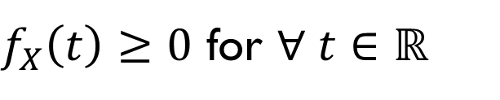
Probability Density Function (PDF) Intuition
$f_{X}\left(t\right)≥0$ for $∀ t∈ℝ$

Slide 10
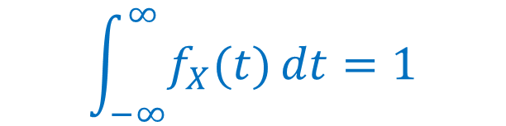
PDF Intuition
$f_{X}\left(t\right)≥0$ for $∀ t∈ℝ$
$$\int_{−∞}^{∞}{f_{X}(t)}dt=1$$

Slide 11
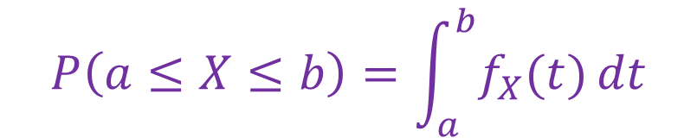
PDF Intuition
$f_{X}\left(t\right)≥0$ for $∀ t∈ℝ$
$$\int_{−∞}^{∞}{f_{X}(t)}dt=1$$
$$P\left(a≤X≤b\right)=\int_{a}^{b}{f_{X}(t)}dt$$

Slide 12
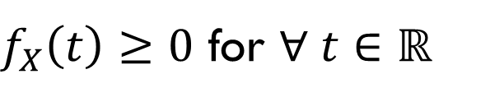
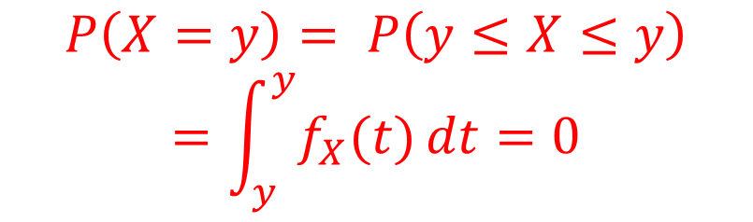
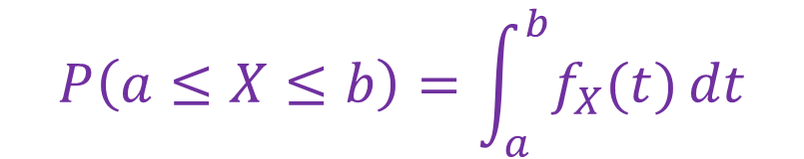
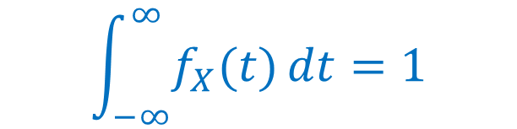
PDF Intuition
$f_{X}\left(t\right)≥0$ for $∀ t∈ℝ$
$$\int_{−∞}^{∞}{f_{X}(t)}dt=1$$
$$P\left(a≤X≤b\right)=\int_{a}^{b}{f_{X}(t)}dt$$
$$P\left(X=y\right)= P\left(y≤X≤y\right)=\int_{y}^{y}{f_{X}(t)}dt=0$$

Slide 13
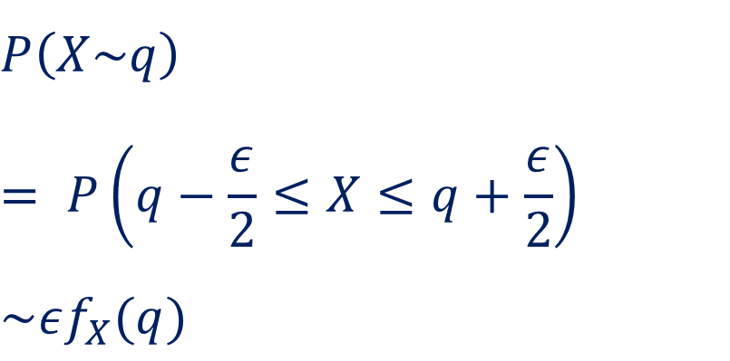
PDF Intuition
$$P\left(X\sim q\right)$$
$$= P\left(q−\frac{ε}{2}≤X≤q+\frac{ε}{2}\right)$$
$$\sim εf_{X}(q)$$

Slide 14
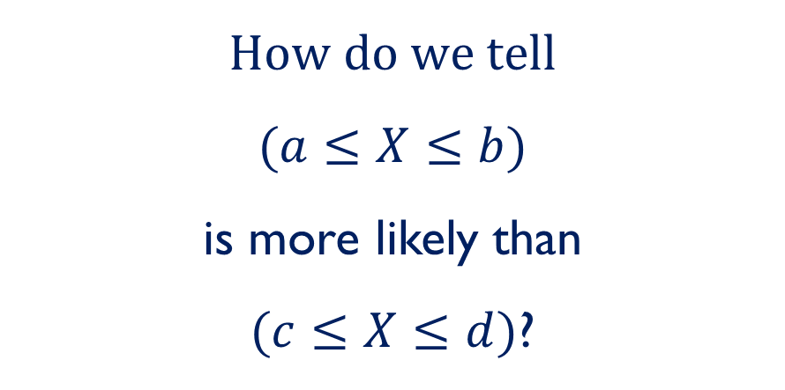
PDF Intuition
$$How do we tell$$
$(a≤X≤b)$
is more likely than
$(c≤X≤d)$?

Slide 15
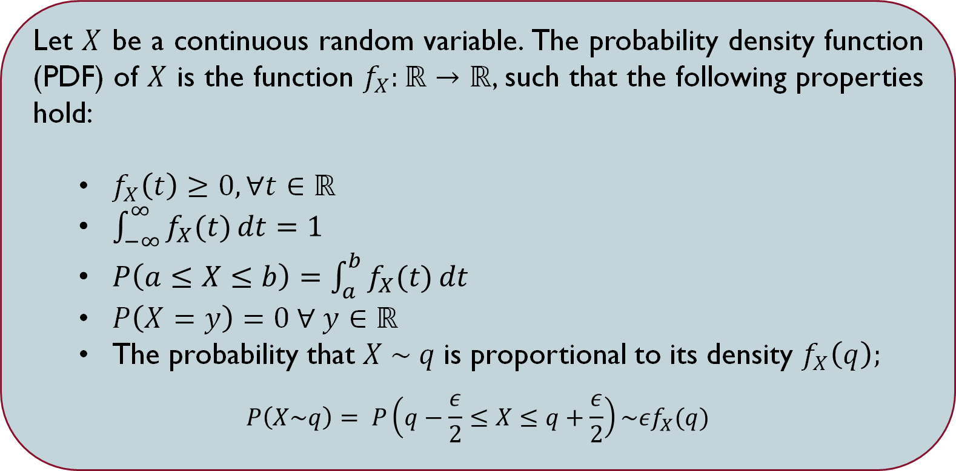
Probability Distribution Function
Let $X$ be a continuous random variable. The probability density function (PDF) of $X$ is the function $f_{X}:ℝ→ℝ$, such that the following properties hold:
$f_{X}\left(t\right)≥0, ∀t∈ℝ$
$\int_{−∞}^{∞}{f_{X}(t)}dt=1$
$P\left(a≤X≤b\right)=\int_{a}^{b}{f_{X}(t)}dt$
$P\left(X=y\right)=0 ∀ y∈ℝ$
The probability that $X \sim q$ is proportional to its density $f_{X}\left(q\right);$
$$P\left(X\sim q\right)= P\left(q−\frac{ε}{2}≤X≤q+\frac{ε}{2}\right)\sim εf_{X}(q)$$

Slide 16

Suppose X has pdf $f(x) = 3$ on $[0, 1/3]$ (this means $f(x) = 0$ outside of $[0, 1/3]$).
Graph the pdf and compute $P(.1 ≤ X ≤ .2)$ and $P(.1 ≤ X ≤ 1)$.

Slide 17

Let $X$ be a random variable with range $[0,1]$ and pdf $f(x) = Cx^{2}$. What is the value of $C$?

Slide 18
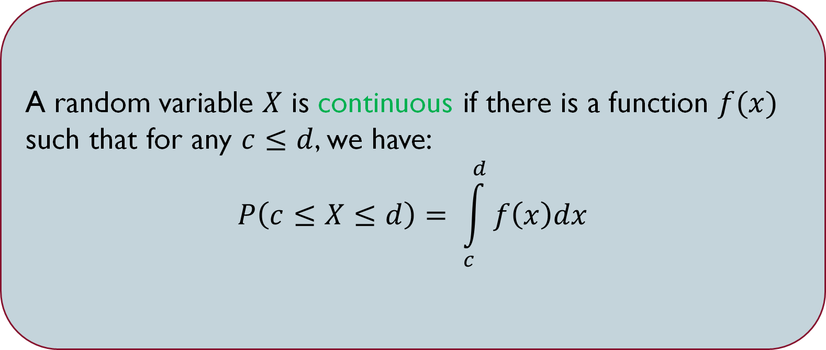
Continuous Random Variables
A random variable $X$ is continuous if there is a function $f(x)$ such that for any $c≤d$, we have:
$$P\left(c≤X≤d\right)= \int_{c}^{d}{f\left(x\right)dx}$$

Slide 19
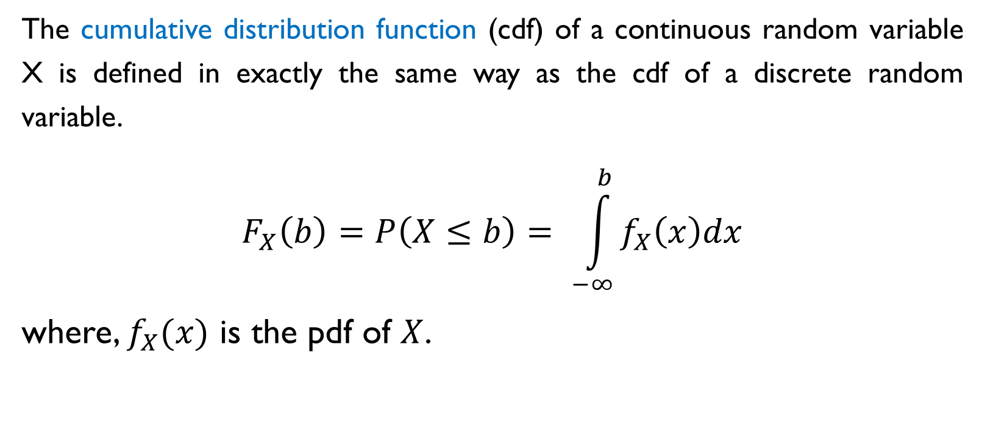
Cumulative distribution function
The cumulative distribution function (cdf) of a continuous random variable X is defined in exactly the same way as the cdf of a discrete random variable.
$$F_{X}\left(b\right)=P\left(X≤b\right)= \int_{−∞}^{b}{f_{X}\left(x\right)dx}$$
where, $f_{X}(x)$ is the pdf of $X$.

Slide 20
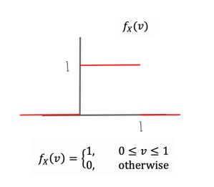
CDF Example
PDF

Slide 21
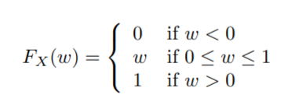
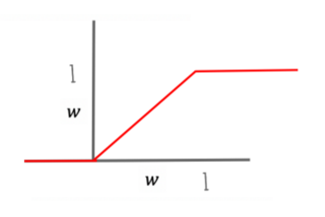
CDF Example
PDF

Slide 22
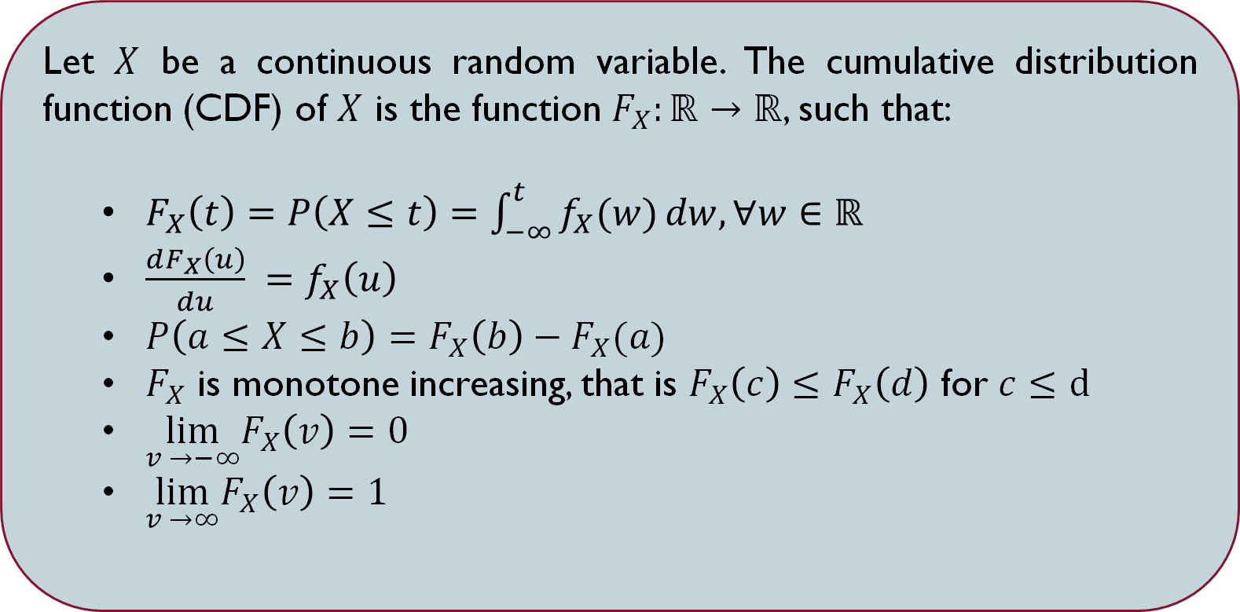
Cumulative distribution function
Let $X$ be a continuous random variable. The cumulative distribution function (CDF) of $X$ is the function $F_{X}:ℝ→ℝ$, such that:
$F_{X}\left(t\right)=P\left(X≤t\right)=\int_{−∞}^{t}{f_{X}(w)}dw, ∀w∈ℝ$
$\frac{dF_{X}\left(u\right)}{du} =f_{X}\left(u\right)$
$P\left(a≤X≤b\right)=F_{X}\left(b\right)−F_{X}(a)$
$F_{X}$ is monotone increasing, that is $F_{X}\left(c\right)≤F_{X}\left(d\right)$ for $c≤d$
$\lim_{v →−∞}F_{X}\left(v\right)=0⁡$
$\lim_{v →∞}F_{X}\left(v\right)=1$

Slide 23
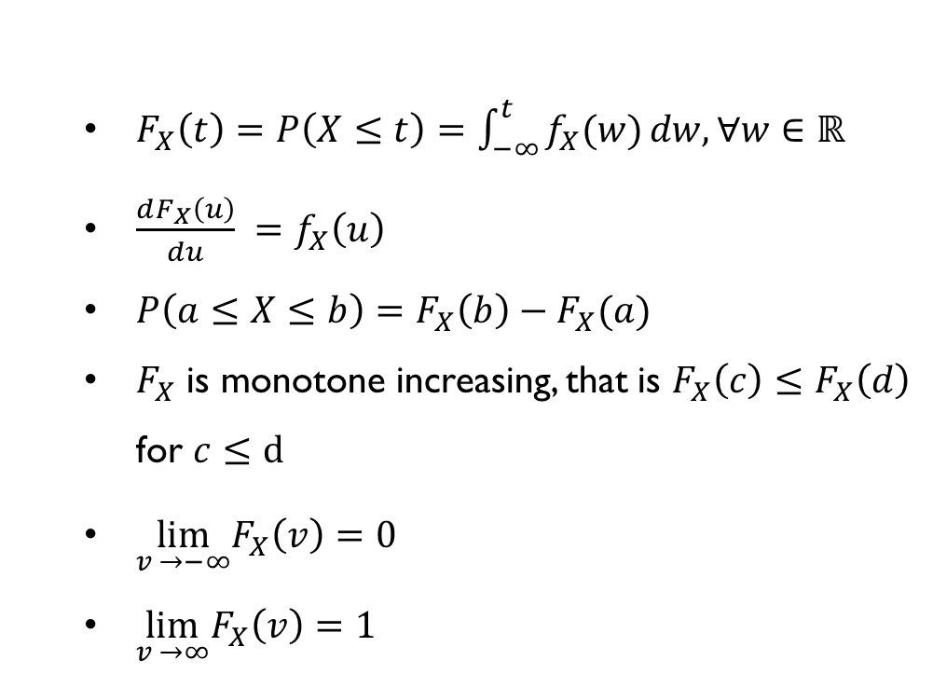
$F_{X}\left(t\right)=P\left(X≤t\right)=\int_{−∞}^{t}{f_{X}(w)}dw, ∀w∈ℝ$
$\frac{dF_{X}\left(u\right)}{du} =f_{X}\left(u\right)$
$P\left(a≤X≤b\right)=F_{X}\left(b\right)−F_{X}(a)$
$F_{X}$ is monotone increasing, that is $F_{X}\left(c\right)≤F_{X}\left(d\right)$ for $c≤d$
$\lim_{v →−∞}F_{X}\left(v\right)=0⁡$
$\lim_{v →∞}F_{X}\left(v\right)=1$

Slide 24
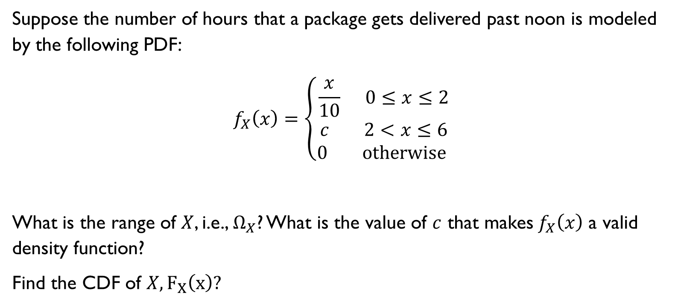
Example
Suppose the number of hours that a package gets delivered past noon is modeled by the following PDF:
$$f_{X}\left(x\right)=\left\{\begin{aligned}\frac{x}{10} 0≤x≤2 \\ c 2<x≤6 \\ 0 otherwise \end{aligned}\right.$$
What is the range of $X$, i.e., $Ω_{X}$? What is the value of $c$ that makes$f_{X}\left(x\right)$ a valid density function?
Find the CDF of $X, F_{X}\left(x\right)?$

Slide 25
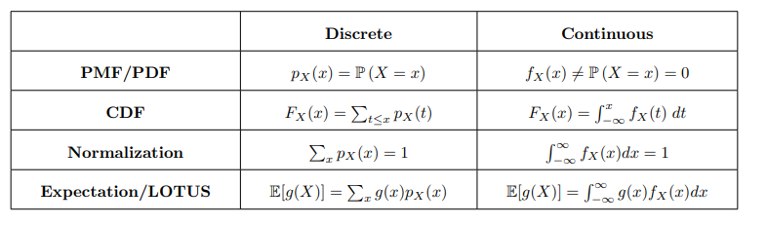
From discrete to Continuous

Slide 26
Summary

Slide 28
CA3: Expectation, Variance, and Gallery of Discrete Random Variables
ACCESS CODE:
discreteRVs!

